Slide 1
UCV Activities Technology – Soap vs Rest
UCV Activities Technology allows the Client Applications the ability to Add, Update, or Retrieve Activities using Soap/XML or Rest/JSON Schemas.
The UCV Activities Journey Technology team members manage the transparency of information being passed by the Client Apps using Soap or Rest Services calls.
The Information captured from the Client Applications share the same data.
All Services are following the Layer 7 Security Standards.
There are separate URLs created to call the Activities Services using Soap/XML and Rest/JSON.
The Recommended approach for all Client Apps is to onboard to Rest Services. Depending on if the Client App has the capability to use REST services instead of Soap.

Slide 2
UCV Activities Technology – Soap vs Rest (Continued)
To Avoid confusions, here is a basic definition of a Soap Service vs a Rest Service:
SOAP stands for Simple (sic) Object Access Protocol. It was intended to be a way to do Remote Procedure Calls to remote objects by sending XML over HTTP. Soap Schemas are following the Accord Standards.
WSDL is Web Service Description Language. A request ending in '.wsdl' to an endpoint will result in an XML message describing request and response that a user can expect. It describes the contract between service & client.
REST uses HTTP to send messages to services.
All UCV Services will be using Rest/JSON Schemas.
All Rest Services continue to be strategically enhanced.

Slide 3
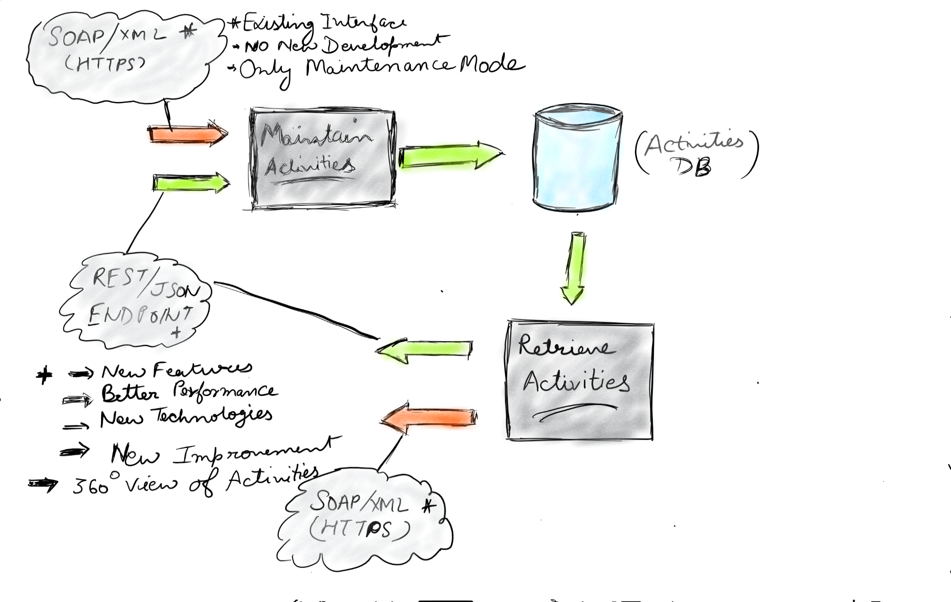
UCV Activities Technology Soap vs Rest (continued)

